Slide 1
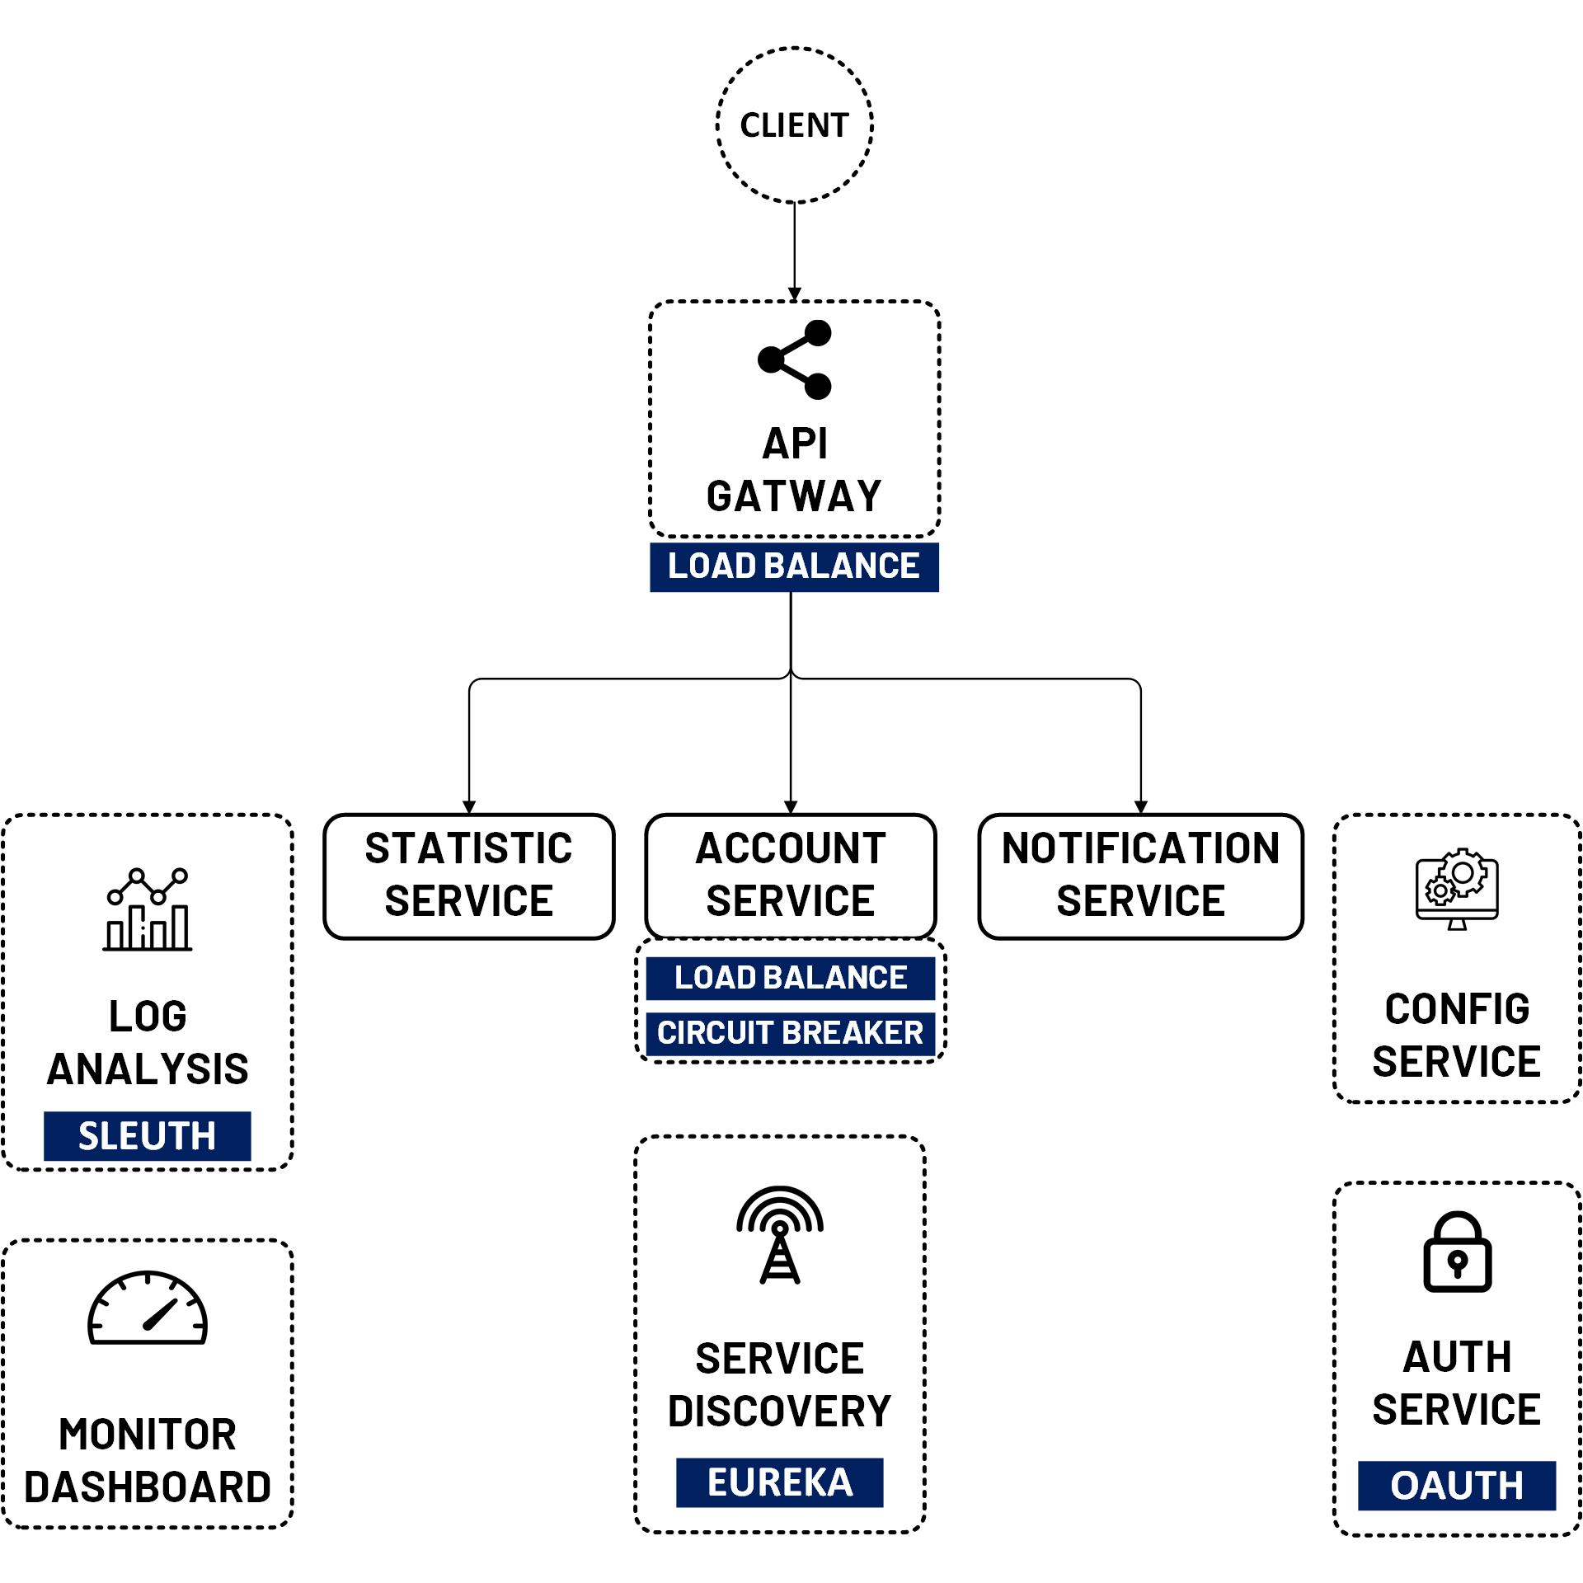

Front End React JS with OAuth 2 Authorization Code
www.jmaster.io/course/microservices-with-spring-cloud

